Slide 1
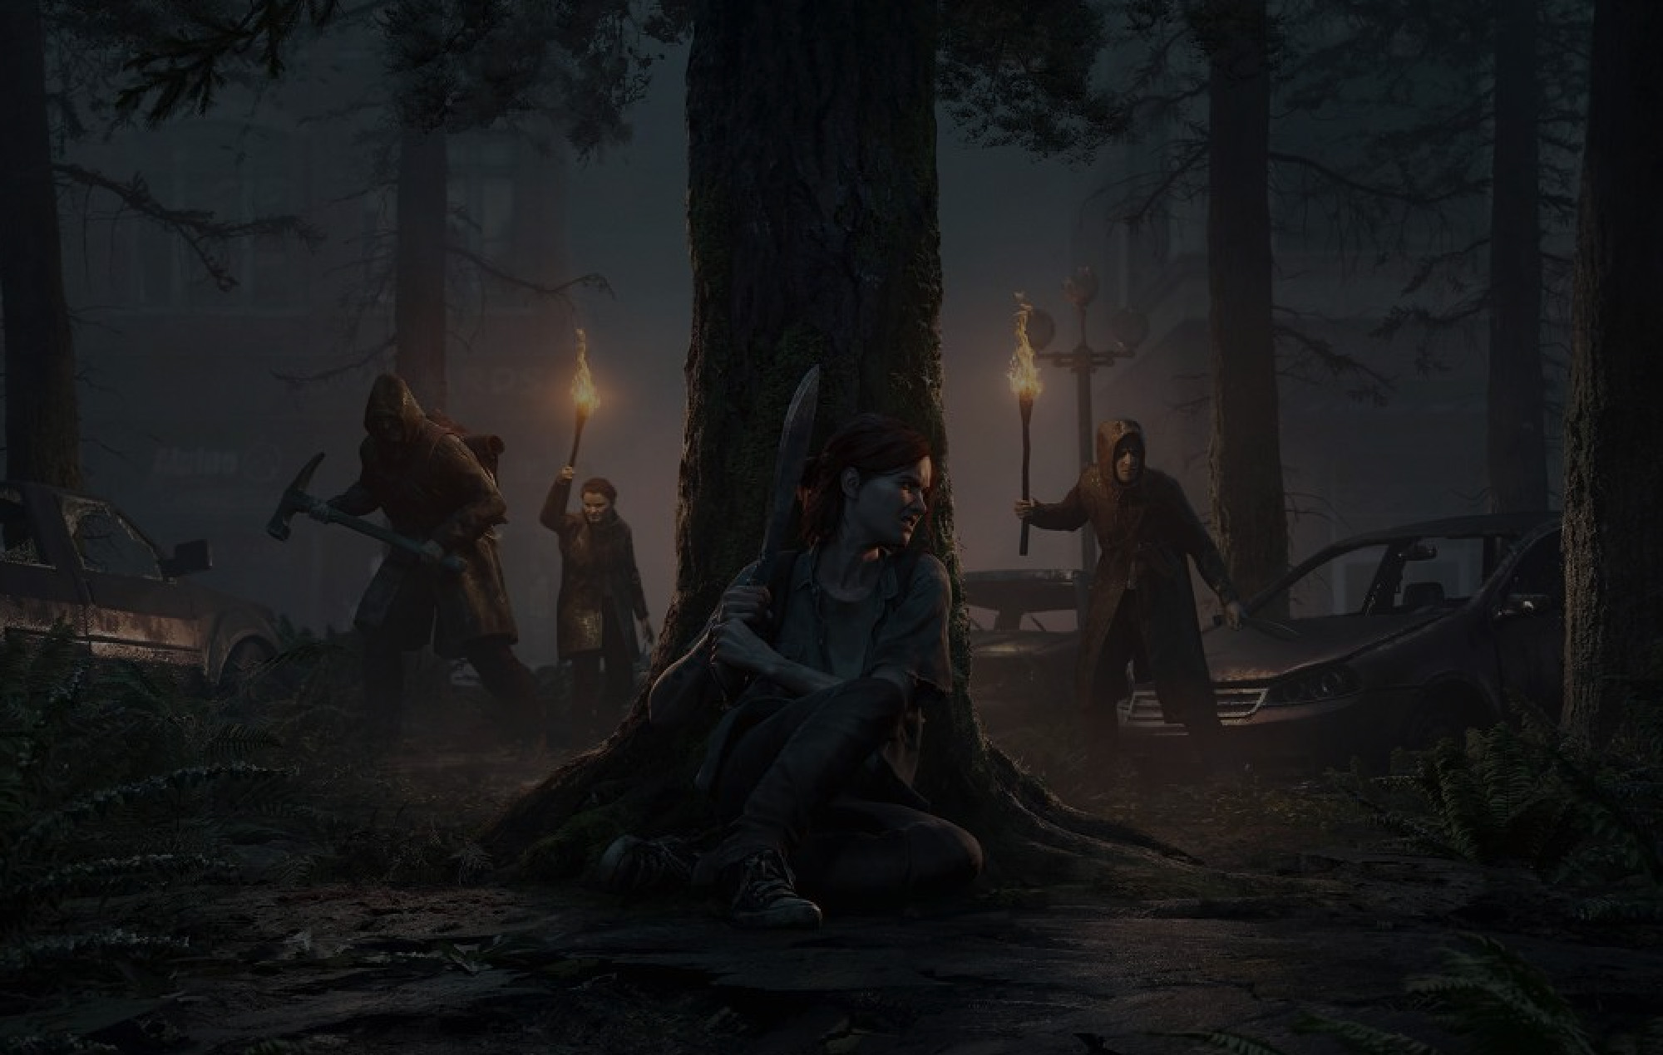
Motion Matching in TLOU2
A Data Driven Animation Solution
Notes:
Hello and Welcome!

Slide 2
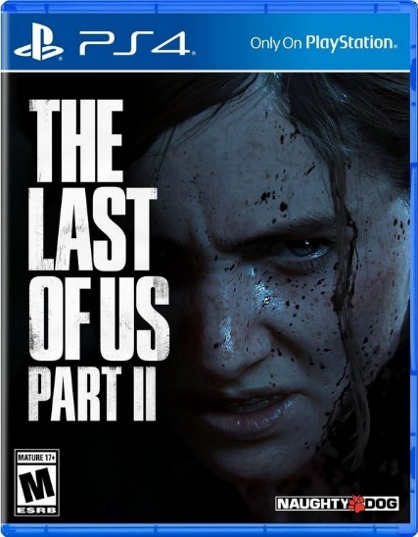
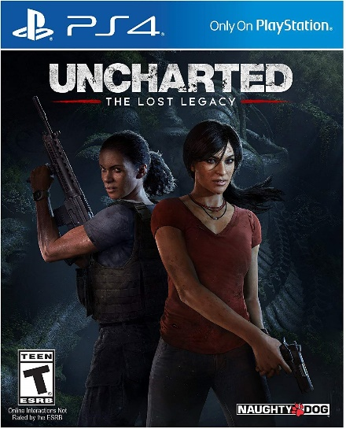


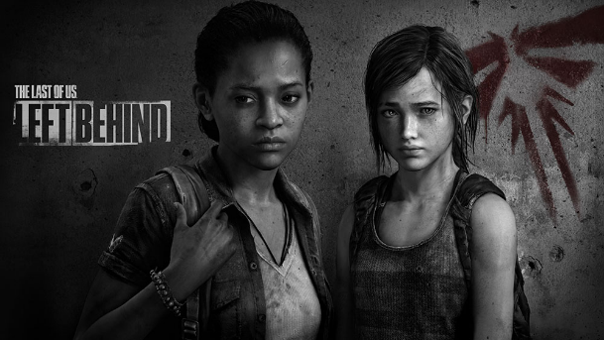
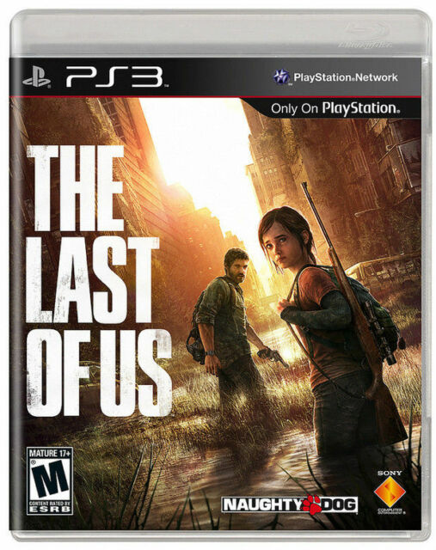
Kan XU:
Gameplay programmer from Naughty Dog
Notes:
First let me introduce myself a little bit.
My name is Kan, I am gameplayer programmer from Naughty Dog.
The projects I worked on are:
The last of Us Part 2
Uncharted: The Lost Legacy
Uncharted 4.
And the original The Last of Us and PS4 remaster.

Slide 3
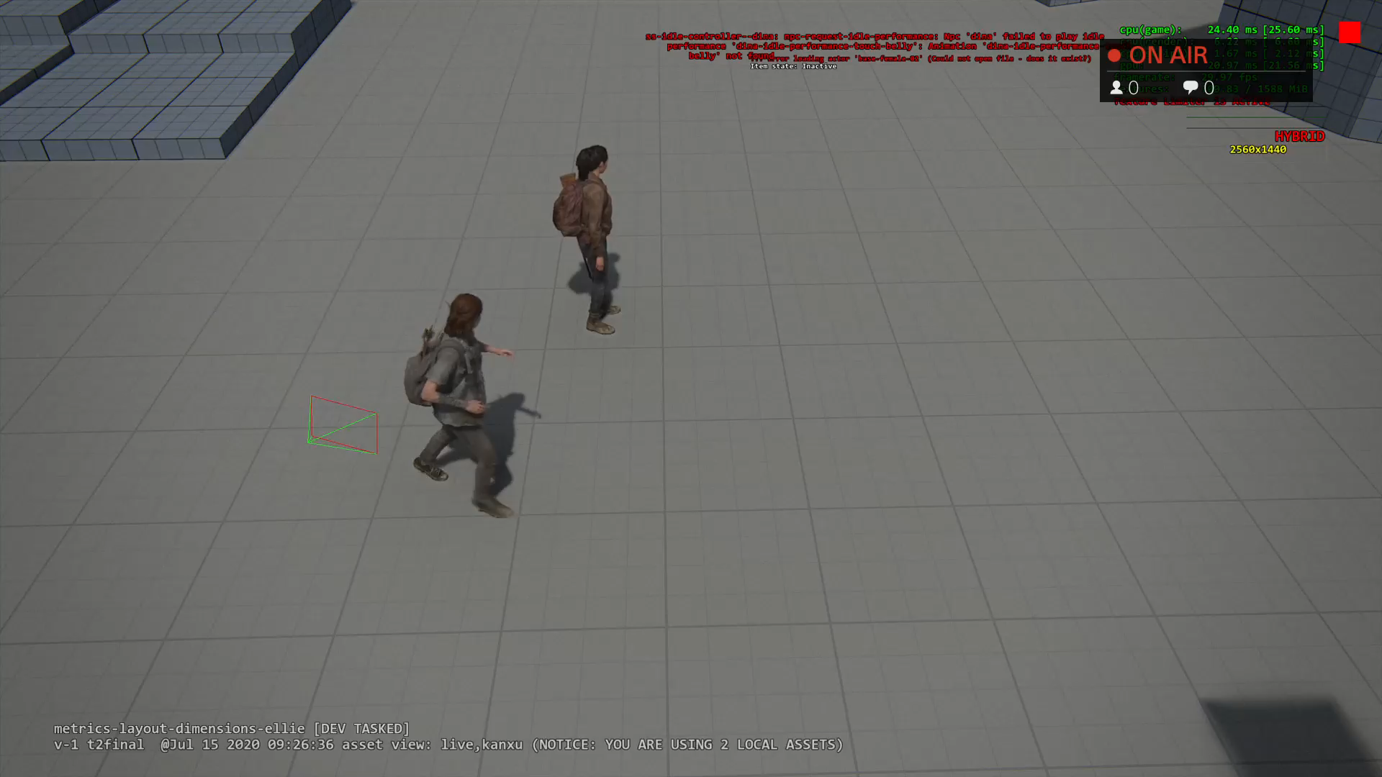
Strafing MM Demo
Notes:
Ok, back to our original topic: motion matching.
First let’s see what motion matching can do:
The last of Us Part 2 is a over the shoulder shooter game.
Player is always strafing, and she is always facing towards camera direction.
This video demonstrates how strafe locomotion works.
I am controlling Ellie using joystick to move her around and change direction a lot.
I can feel she is very responsive.
And also you will notice she does foot planting and weight shifting when changing direction.
Looks pretty nice.

Slide 4
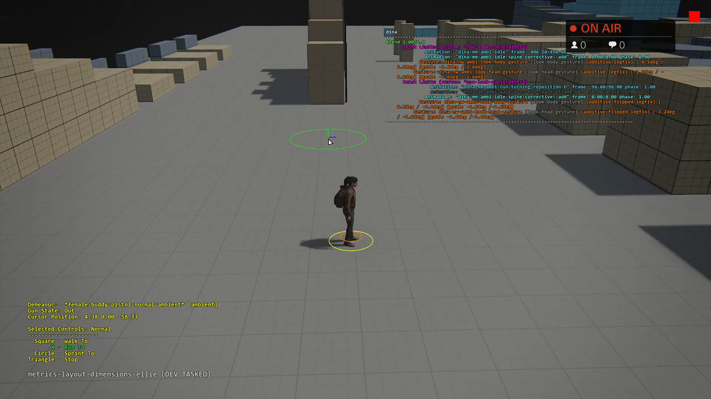
Non Strafing MM Demo
Notes:
Of course motion matching can work with non strafing locomotion and Npc too.
This is Buddy Npc Dina. I am using mouse to move her around.
You will notice foot planting, weight shifting when she changes direction too.

Slide 5
Traditional animation system
Blend tree and parametric blending
Layering
State machines
Phase matching
Notes:
Before we dig into Motion Matching, let’s take a quick look at the traditional animation system first.
This will give us motivation why do we need motion matching.
Current-Gen video games usually need the following tools to reach AAA quality:
…
Let’s take a look at each tool.

Slide 6
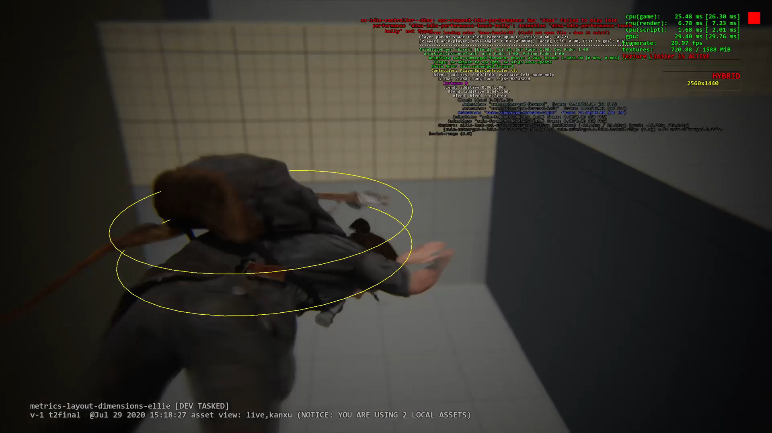
Blend tree and parametric blending
Notes:
Blend tree and parametric blending:
This is a screenshot Ellie swim underwater.
It’s single animation state but it has 5 animations blended as a tree.
One Forward animation as base, plus 4 additive animations including up, down, left and right.
When she slightly changes direction, programmer need change additive animation blend weight.
These additive animations will add subtle details which makes turning around looks more natural.

Slide 7
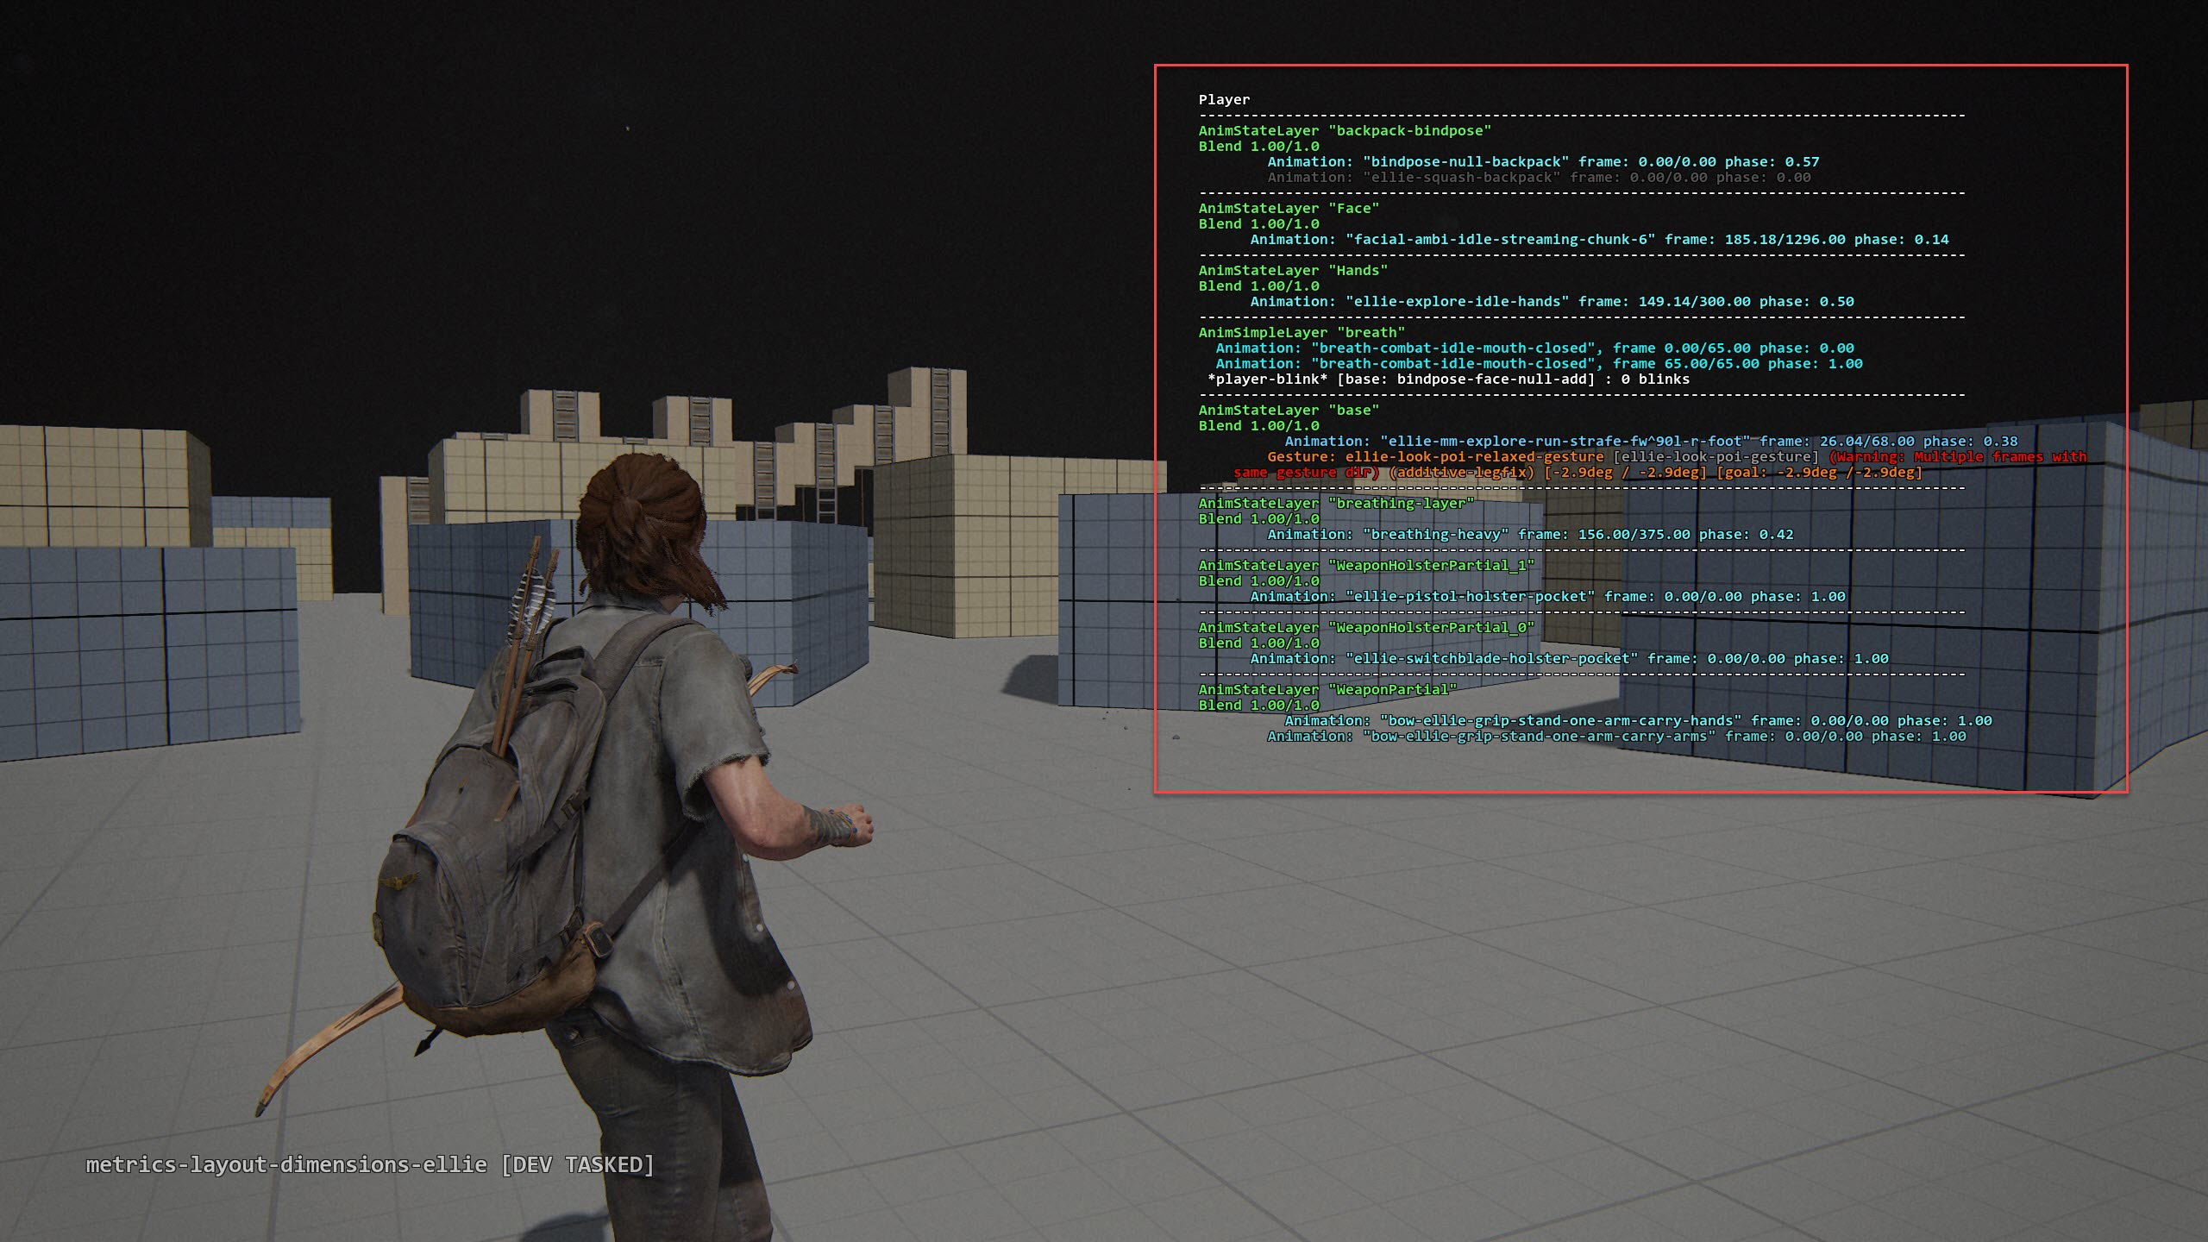
Layering
Notes:
The next thing is layering.
Player can have up to 60 anim layers. But not of them running all the time.
This is a screenshot Ellie’s running around with her bow out.
Some of the key layers are:
Base layer, it’s for locomotion. This is implemented by motion matching.
Face layer, it’s facial animation
Breath layer, it’s for breath and heart beating.
Weapon Layer: it’s for holding the weapon, switch weapon and reload, etc.

Slide 8
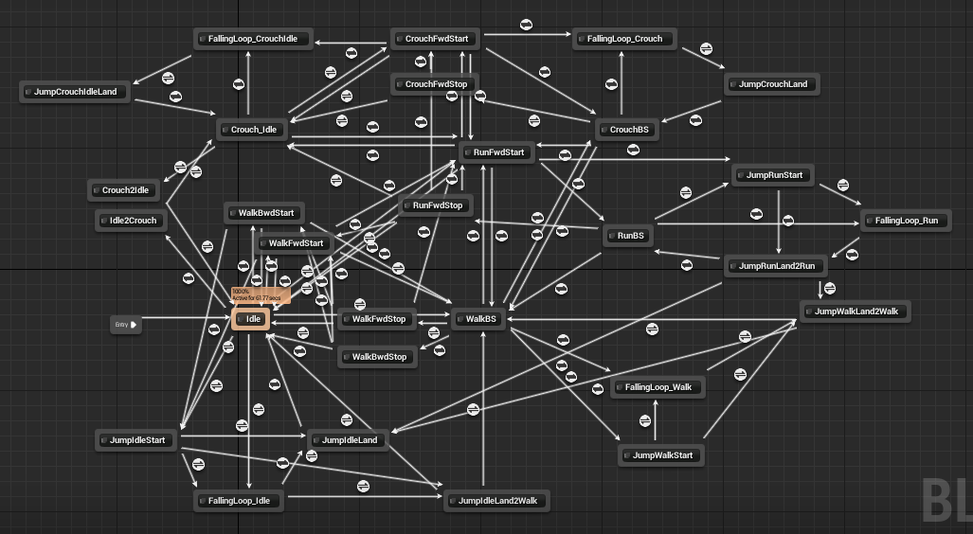
Animation State Machine
Notes:
Animation state machine:
This is a screenshot of unreal locomotion state machine.
We can see there’s many states and many transitions here.
Let’s say animator wants to add a sharp turn animation from left to right, programmer needs add a new “sharp turn” state and a few transitions to fix the links.
The more animations there’re, the more states and transitions programmers need manage.
Of course this graph will become very complicated for AAA game.

Slide 9


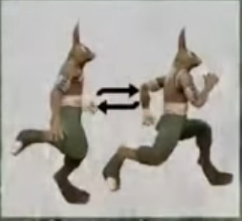
Phase matching
Animator need do a lot tagging.
Foot pass
Foot reach
Notes:
State machine solves the problem of which animation to play.
The next question is which frame it should start.
The comes “Phase matching”:
The idea is given the current pose, we need find a similar pose in the next anim.
To do this: animators need do a lot tagging:
Usually they need tag left foot passes right foot, left foot reaches the ground, right foot passes left foot, right foot reaches the ground.
Then gameplay code can find the similar pose by comparing foot event.
It’s a boring and repetitve process for animators. Whenever they change the animation, they have to tag it again.

Slide 10
Drawback of traditional system
Complexity:
Huge web of state-machine
Hard to implement transitions (lose fidelity)
Lots of layers
For Animators:
Lots of tagging for phase matching
Notes:
I am sure you already see some problems with traditional system.
First, the giant state machine is hard to maintain, also very hard to add new state.
Second, It’s hard to implement transitions.
For example, it’s extremely hard to implement things like sharp turn in the middle of another sharp turn.
Usually we just wait for the first turn finished and start the next turn. But that introduce latency.
Lot of layers. In my opinion, It’s not too bad because most of layers are independent to each other.
But we still want to reduce the number of layers.

Slide 11
Motivation of motion matching
There’s a lot details presented in mocap data:
Change directions
Foot planting
Weight shifting
How can we extract them?
Notes:
So all these drawbacks give us the motivation of motion matching.
If we look at the mocap data:
We see a lot of fine details:
***
Those are hard to be implemented but it’s there.
How can we extract them?

Slide 12
Motivation (cont.)
Let’s forget about state machines, blend-tree, etc.
Why not think mocap data as a pose database?
Notes:
Let’s forget about the old techniques for a while.
Why not think mocap data as a collection of poses, or a big pose database.
And given character’s current pose, why not try find the best matching one from this database?

Slide 13
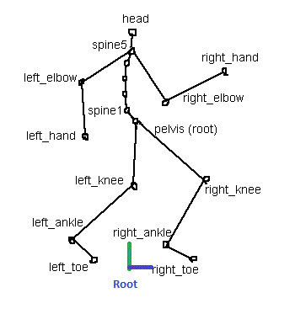
Terminology
Animation Rig
Animated Hierarchy
Root
Root motion
Notes:
Before getting to that database idea, let’s first talk about terminology so everyone is on the same page.
This is simplified animation rig.
The pelvis is root node, it has 3 child nodes: spine1, left_knee, right_knee.
Left_knee has child node left_ankle, left_ankle has child node left_toe.
Since it’s a tree structure we can also call it animated hierarchy.
Another term is root. It is a locator usually the center of 2 feet. It’s for determine character location on the ground.
When we talk about root motion, we are talking about movement of root locator.

Slide 14
Desired trajectory from gameplay
Gameplay wants character to move
Animation system makes the movement looks believable
Gameplay code can provide a desired trajectory
For player, we can convert joypad input to a desired trajectory
For NPC, the navigation path is the desired trajectory naturally
Notes:
Back to motion matching.
Gameplay wants character to move
And the job of animation system is to make that movement looks believable.
To move the character, gameplay code can always provide a desired trajectory.
For player, we can convert joypad input to a desired trajectory
For NPC, the navigation path is a desired trajectory

Slide 15
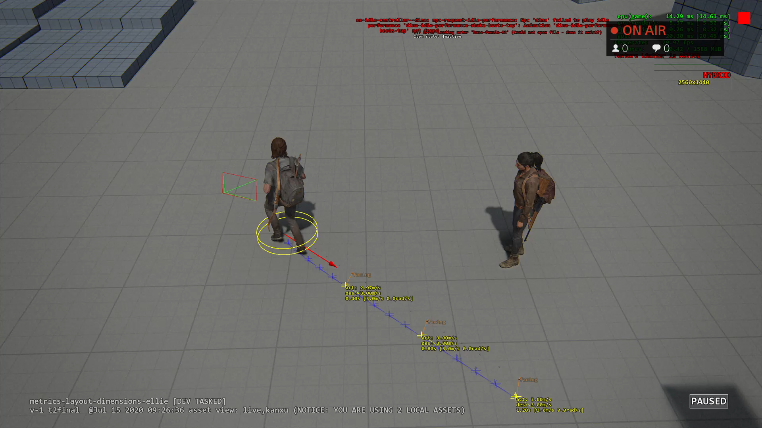
Desired trajectory from gameplay
Notes:
This video shows how to get a desired trajectory for player.
Here the red arrow is my joypad input.
With her current velocity, plus some spring and I can easily generate a smooth trajectory curve.

Slide 16
Match the desired trajectory
Search the “pose database” and find one which best matches the desired trajectory.
Small database:
4 animations: 25 frames each
100 frames = 100 poses
Notes:
Now we have the desired trajectory from gameplay.
the next thing is to search our pose database and find one which best matches the desired trajectory.
Let’s say we have a small “pose” database:
It has 4 animations, each animation is 25 frames.
Then we have 100 poses.
Each frame we just need one pose match the desired trajectory the best.

Slide 17
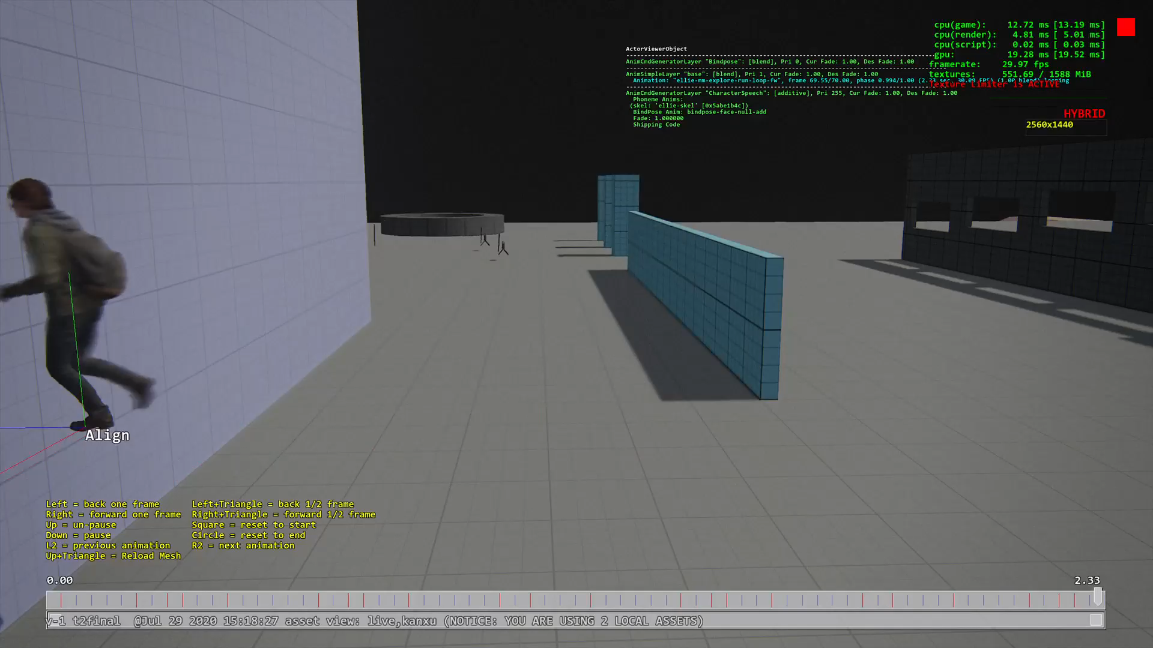
Notes:
Let’s use ellie running forward animation as an example.

Slide 18
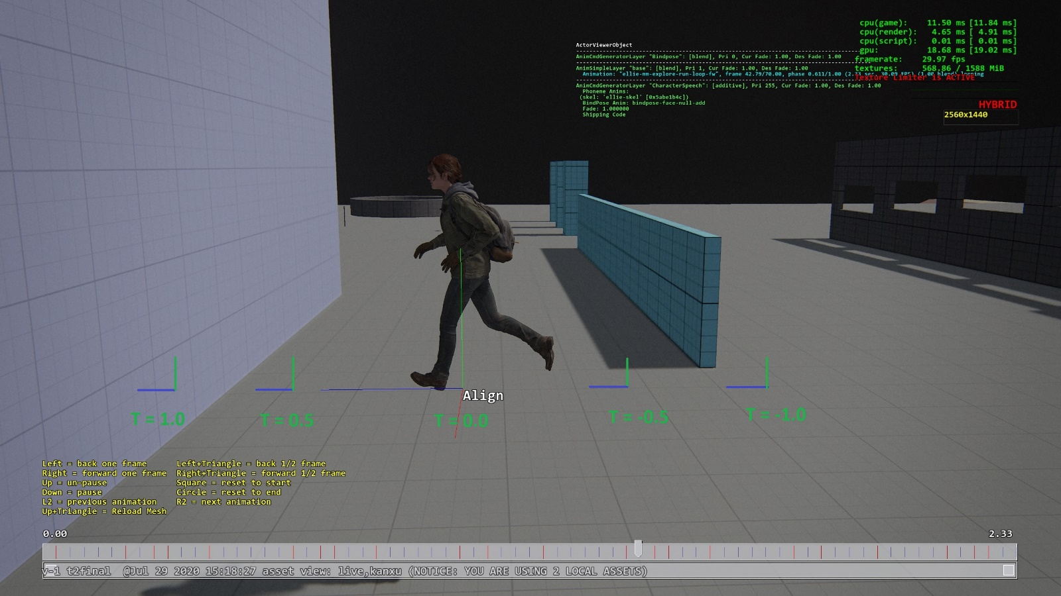
Get trajectory from a pose
Root motion is a trajectory
Think pose’s trajectory as a function of time: traj(t)
Notes:
You might ask, how to get a trajectory from an animation pose?
Isn’t pose just static?
The answer is no. We just saw the animation. The root is moving. It’s definitely a trajectory.
We can think pose’s trajectory as a function of time: traj(t)
This picture show pose at frame 42.
If t is zero, this function returns the root locator of this pose.
If t is 1, it returns the root locator 1s ahead.
If t is -1, it returns the root locator 1s ago.
So we can look ahead and look back of time to get a pose’s trajectory.

Slide 19
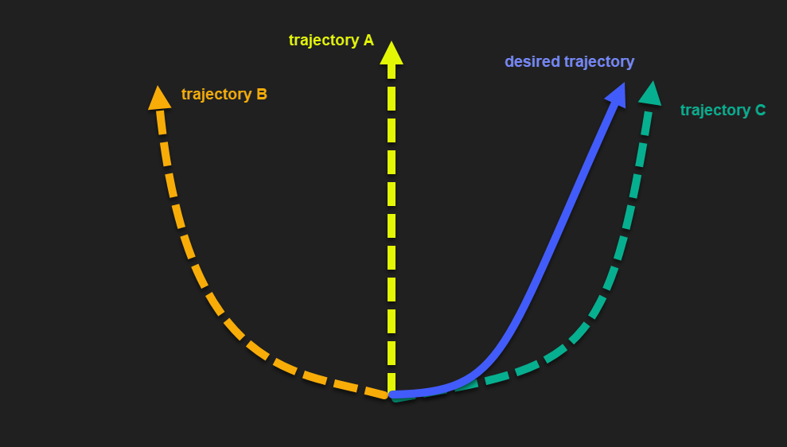
Matching Trajectory Curves
Calculate its “distance” between the desired trajectory.
Notes:
Now we have desired trajectory and trajectory from a pose. How do we find the best one.
Let’s take a look at a simple example first:
We have trajectories from 3 poses, A, B, C.
We also have desired trajectory, which is this blue curve.
Which pose’s trajectory matches the desired trajectory the best? It should be the green one.
How do we turn that into code?

Slide 20
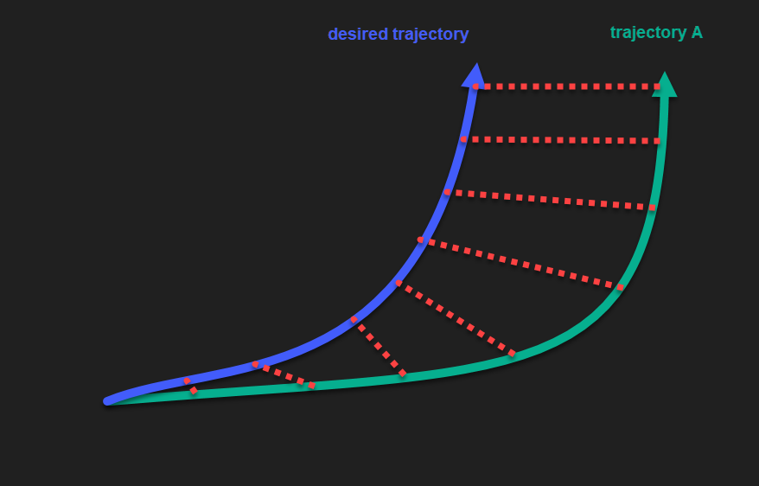
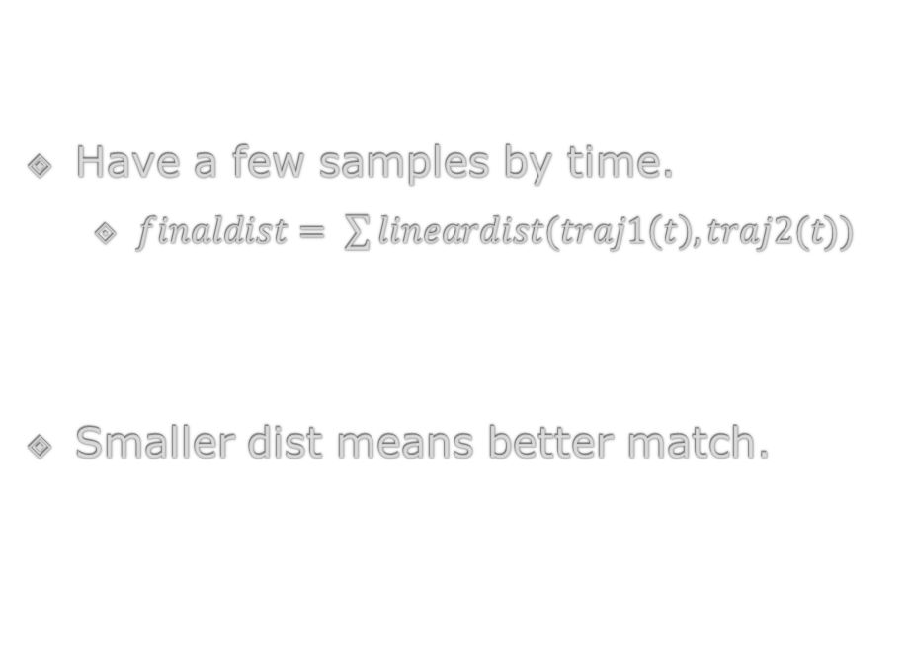
“Distance” between 2 Trajectories
Have a few samples by time.
$finaldist= \sum{lineardist(traj1\left(t\right), traj2(t))}$
Smaller dist means better match.
Notes:
We need a way to measure distance between 2 trajectories.
We can have a few sample points by time.
Let’s say it’s 0.1s, etc.
Smaller distance means better match. Just imagine if 2 trajectories are exactly the same, the distance will be zero.

Slide 21
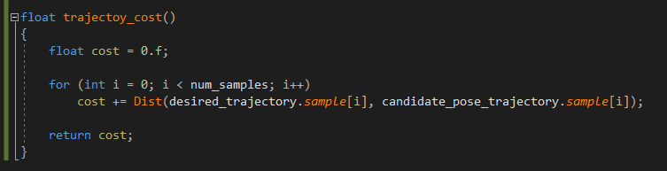
Pseudo code
Notes:
Here’s the pseudo code:
It just sum up the sample points distance.

Slide 22

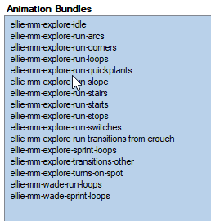
Data set
player explore locomotion set:
183 animations
8866 poses
Notes:
Here’s the data set:
It’s player explore locomotion set.

Slide 23
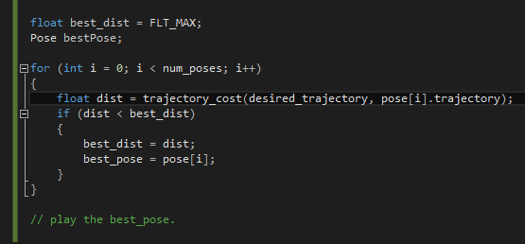
First algorithm
Notes:
With cost func and data set, we can develop our first algorithm.
Small note: desired_trajectory is global space, pose[i].trajectory is in root space
We need transform desired_trajectory into that root space

Slide 24
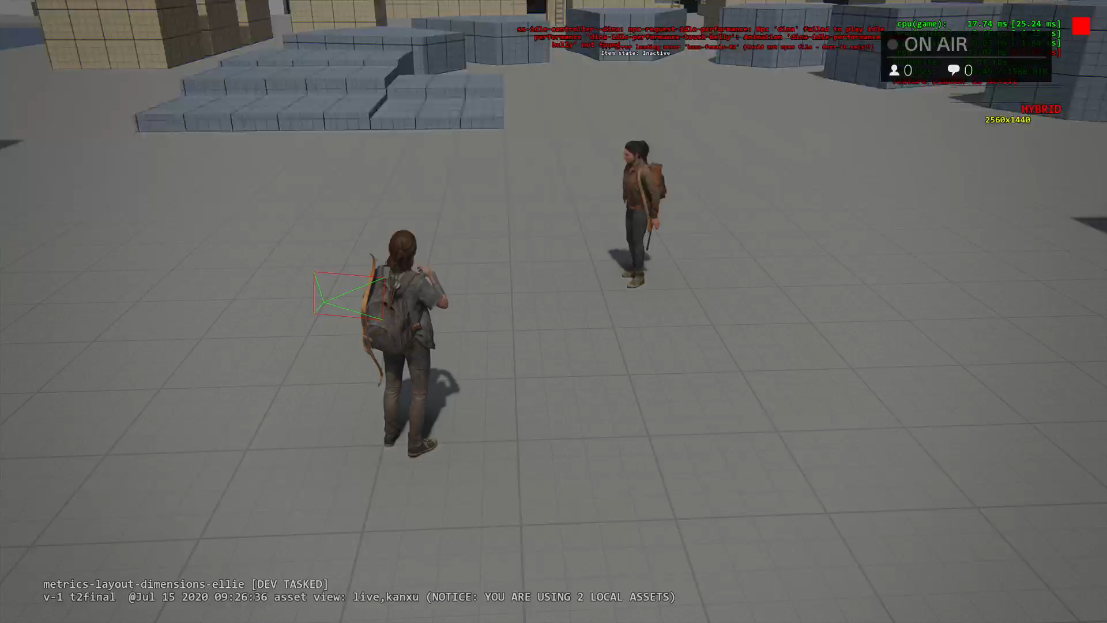
Result of matching desired trajectory only
Notes:
Let’s see how it works.
Player can follow my joypad input very well.
However she is not animating correctly.

Slide 25
What’s the problem?
Matching trajectory only doesn’t play animation at all.
Notes:
So what’s wrong?
Right now we just match the desired trajectory, our character doesn’t play animation at all.

Slide 26
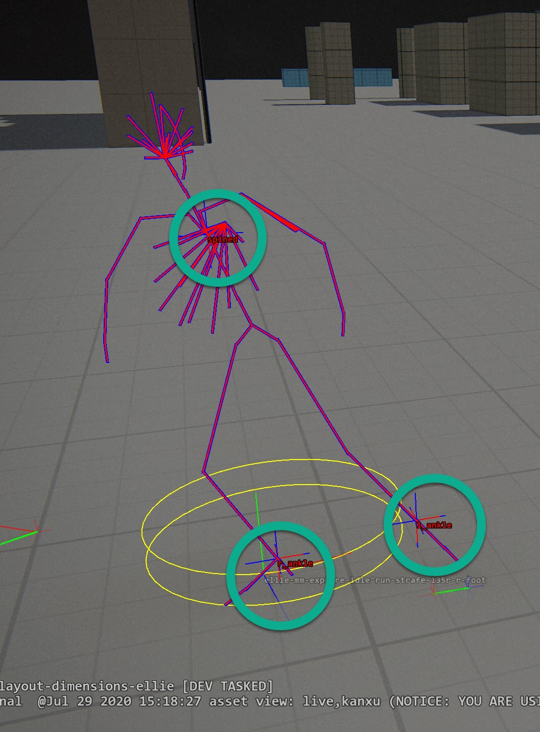
Pose Matching
We need also take “pose” into consideration.
What’s a “pose”?
A pose is a list of joints information.
Each joint has 2 key features:
Position
Velocity
Notes:
To solve that, we also need take pose into consideration.
So what is a pose?
A pose is a list of joints information, including position, rotation, velocity, etc.
And the key features for pose matching are: position and velocity.

Slide 27
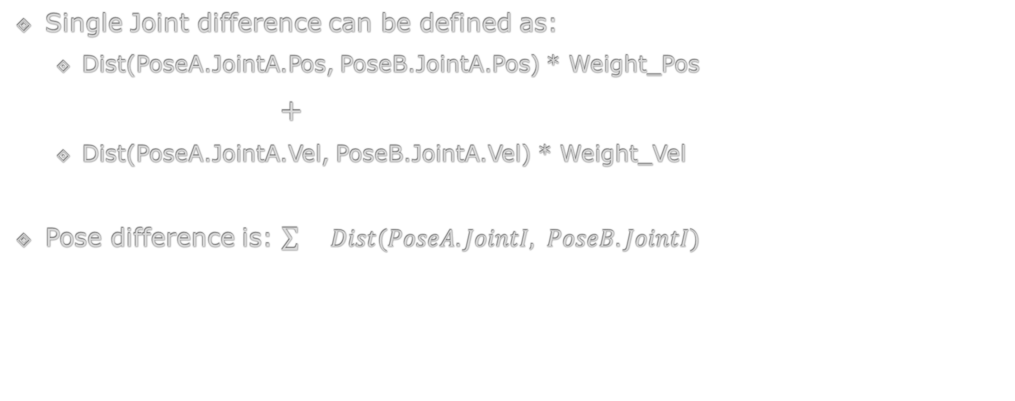
“Distance” between 2 poses
Single Joint difference can be defined as:
Dist(PoseA.JointA.Pos, PoseB.JointA.Pos) * Weight_Pos
+
Dist(PoseA.JointA.Vel, PoseB.JointA.Vel) * Weight_Vel
Pose difference is: $\sum{}Dist(PoseA.JointI, PoseB.JointI)$
Notes:
Just like we measure the distance between 2 trajectories. We can also measure the distance between 2 poses.
For each joint, we can calculate the position distance and velocity distance.
Since they’re 2 kinds of units, we need some weight to normalize them.
And pose distance is simply sum up all joints distance.

Slide 28
Which joints for pose matching?
For performance, we don’t want all joints.
We just need most relevant joints:
L_ankle, R_ankle, Spine for biped locomotion
Notes:
For performance reason, we don’t want to use all the joints.
We just want to use the important joints:
For human locomotion, it’s ……

Slide 29
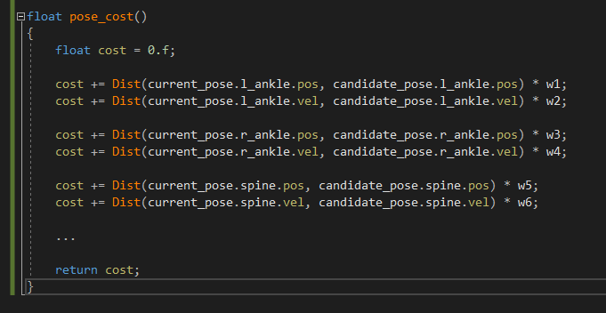
Pseudo code

Slide 30
Second cost function
Updated cost function:
trajectory_dist()
+
pose_dist()
They’re different kinds of units
Need weights to normalize them.
Notes:
Trajectory_dist is calculated by sample points.
Pose_dist is calculated by joints difference.
Now we have the updated cost function.

Slide 31
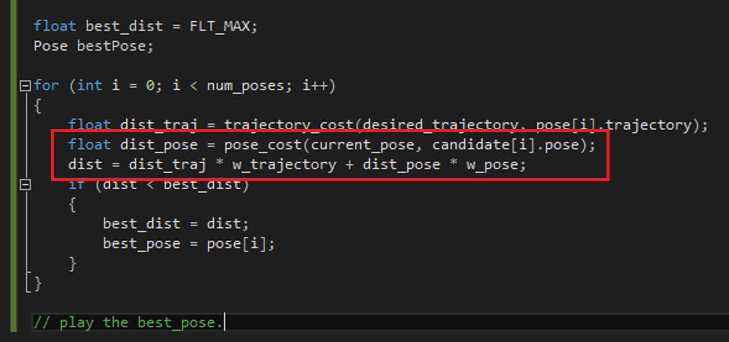
Second Algorithm
Notes:
Here’s our second algorithm: the only difference is we’re adding pose_dist here.
There’s also a weight for trajectory and a weight for pose.
You can imagine it’s a slider between [0-1].
If it’s closer to 0, it trends to find similar trajectory.
If it’s closer to 1, it trends to find similar pose.

Slide 32
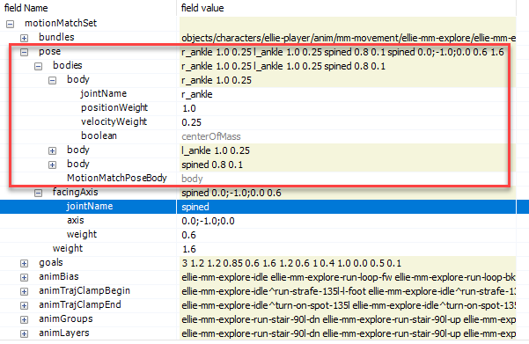
Pose weights
Notes:
After a few days playing with these numbers, here’s some pose weights for player locomotion set.
Explain.

Slide 33
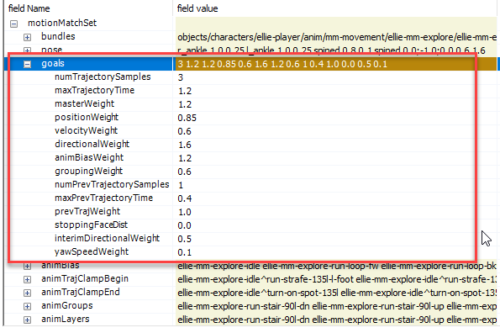
Trajectory weights
Notes:
Here’s some weights for trajectory.

Slide 34
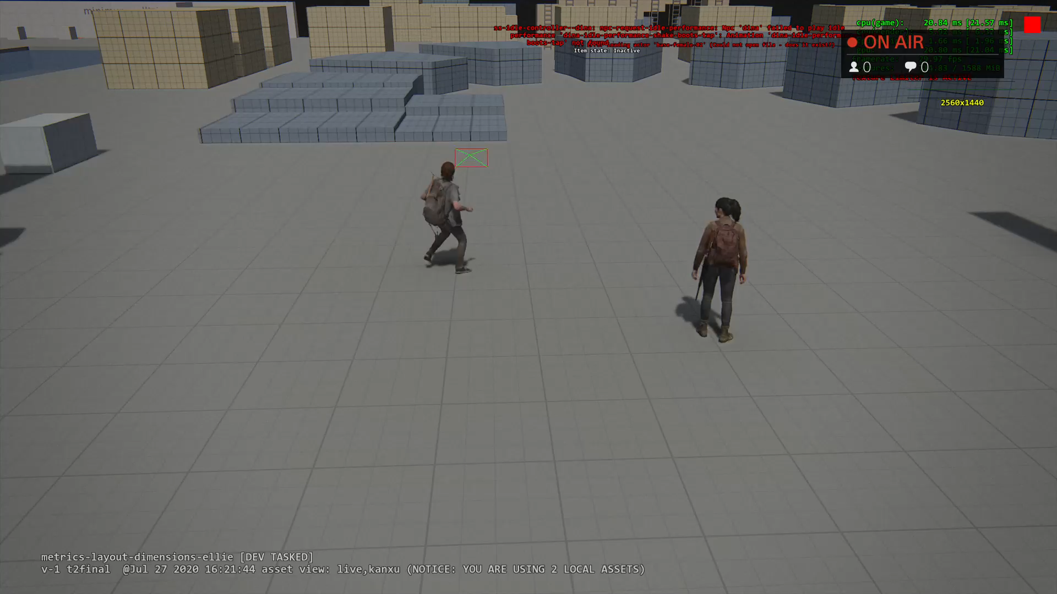
Result of pose matching
Notes:
Let’s see the result of second algorithm.
It feels very responsive. She also does foot planting, body weight shifting. Looks very promising.
Are we done? Can we ship with this?

Slide 35
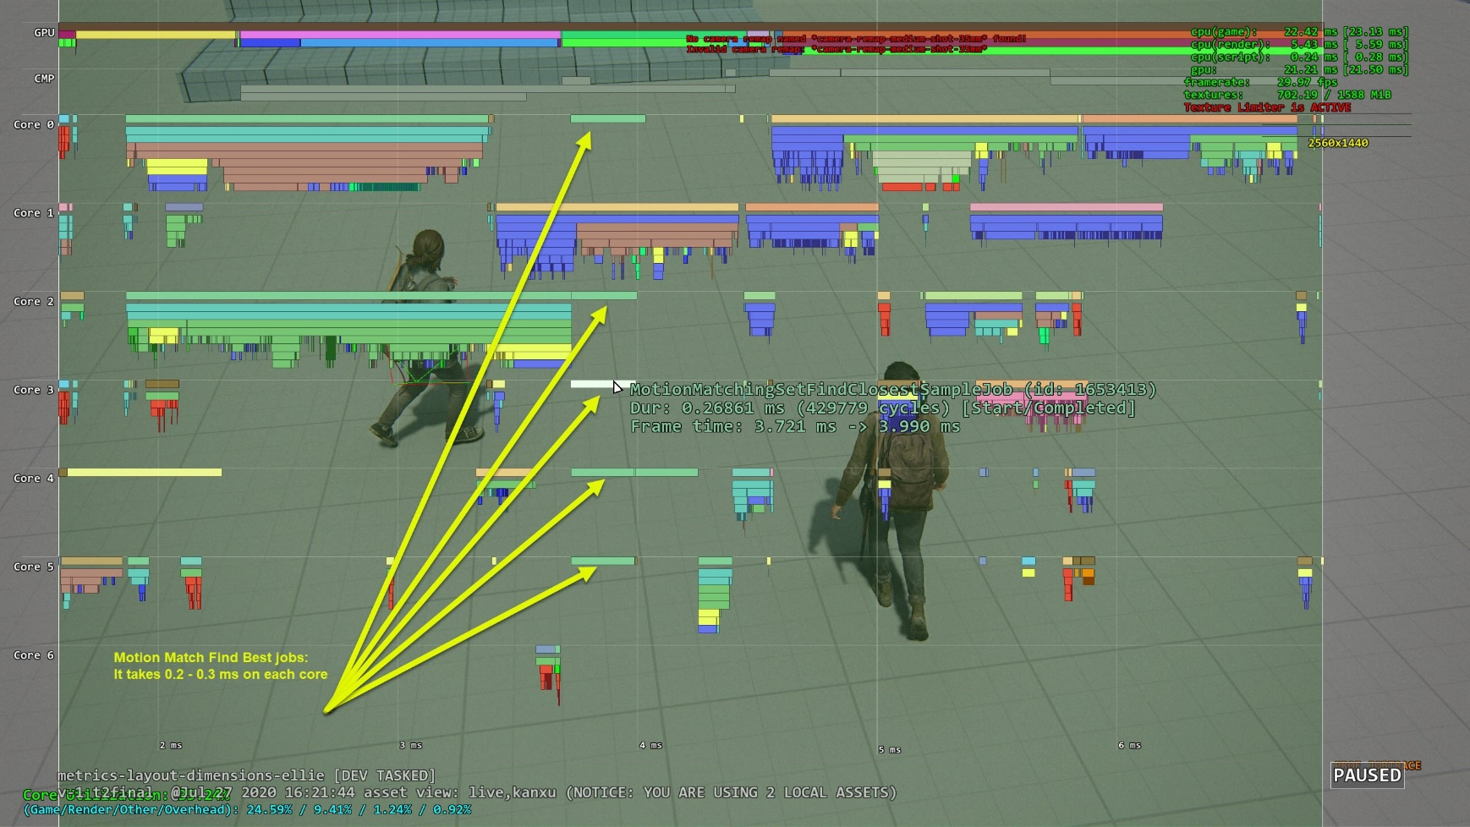
Performance of brute force algorithm
Notes:
Let’s do profiling a little bit:
It’s a loop of 8000 iterations, it will take about 3ms for one core using SIMD.
If it’s even distributed on 6 cores, each core takes 0.5ms.
And this is just for one character. We have up to 16 npcs running at the same time.
It’s just too slow.

Slide 36
Optimization
Brute force search all candidate poses is bad.
First Idea: Run search algorithm on GPU:
Compute shader to compute cost.
Another shader to reduce and find the lowest cost.
Downside of compute job.
Kick compute job onto GPU and wait for result has latency.
MM needs be finished before animating character at the same frame.
Notes:
We still need to solve the performance issue.
We all know brute force search all candidate poses is bad.
So what can we do?
Look at the algorithm, we can easily find each iteration is independent of others.
It seems we can easily run the search algorithm on GPU.
We just need write a computer shader to calculate the cost function.
Another compute shader to reduce and find the pose with lowest cost.
Kick compute job onto GPU and wait for its result has undetermined latency:
We have many other compute jobs running at the same time.
For example:
mesh raycaster: we shoot a bunch rays to renderable geometry. It’s for bullet decal, blood effect, character feet IK, etc.
AI exposure map: It’s shooting rays from Npc’s eyes to area around player. So we know what area around player is exposed to enemy.
Buddy Npc can use that to plan a safe path without being noticed by enemy.
The solves a big issue in original game buddy npc running around but enemy just ignore her.
All those compute jobs are kicked this frame, but we use the results next frame.
However MM must finish as soon as possible because lot of player system needs know what anim is played this frame. For example, IK.
We can’t wait a frame.

Slide 37
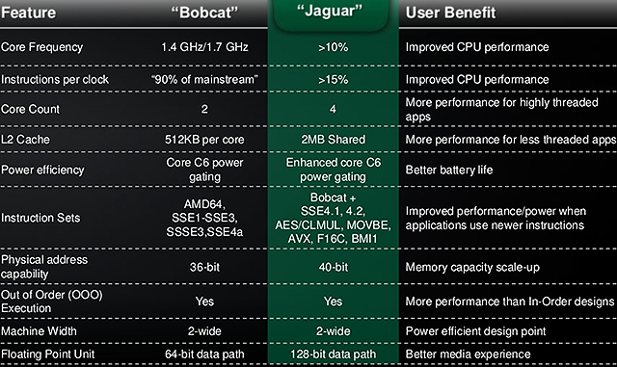
Can we run MM on CPU fast enough?
Notes:
So we give up the compute shader idea .

Slide 38
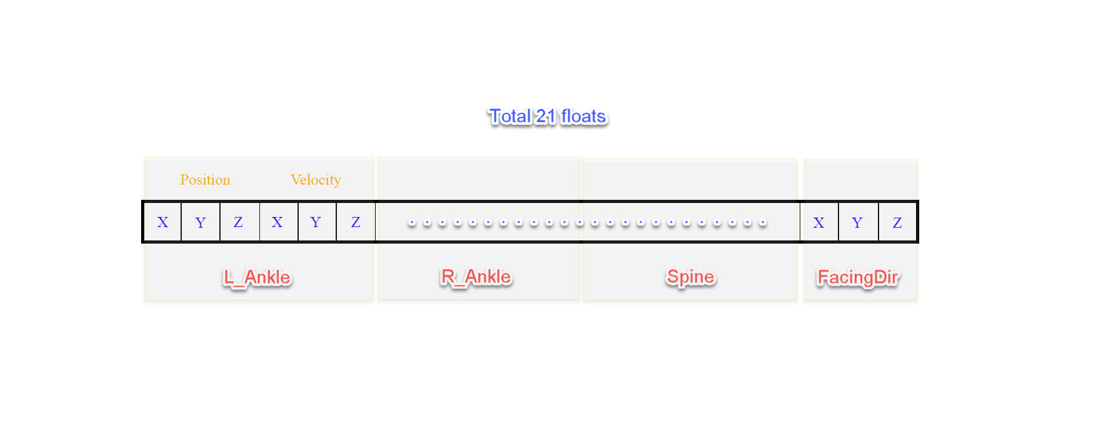
Look at the data
4 samples for trajectory:
(4 * (kPosCount + kVelCount + kFacingCount + kYawSpeedCount)) => 40 floats
Combine them, each pose can be represented as a 61dimension vector.
Notes:
Let’s learn the data a bit.
For Each Pose:
3 joints (l_ankle, r_ankle, spine) + 1 facing direction (strafing).
(3 * (kPosCount + kVelCount)) + kFacingCount => 21 floats

Slide 39
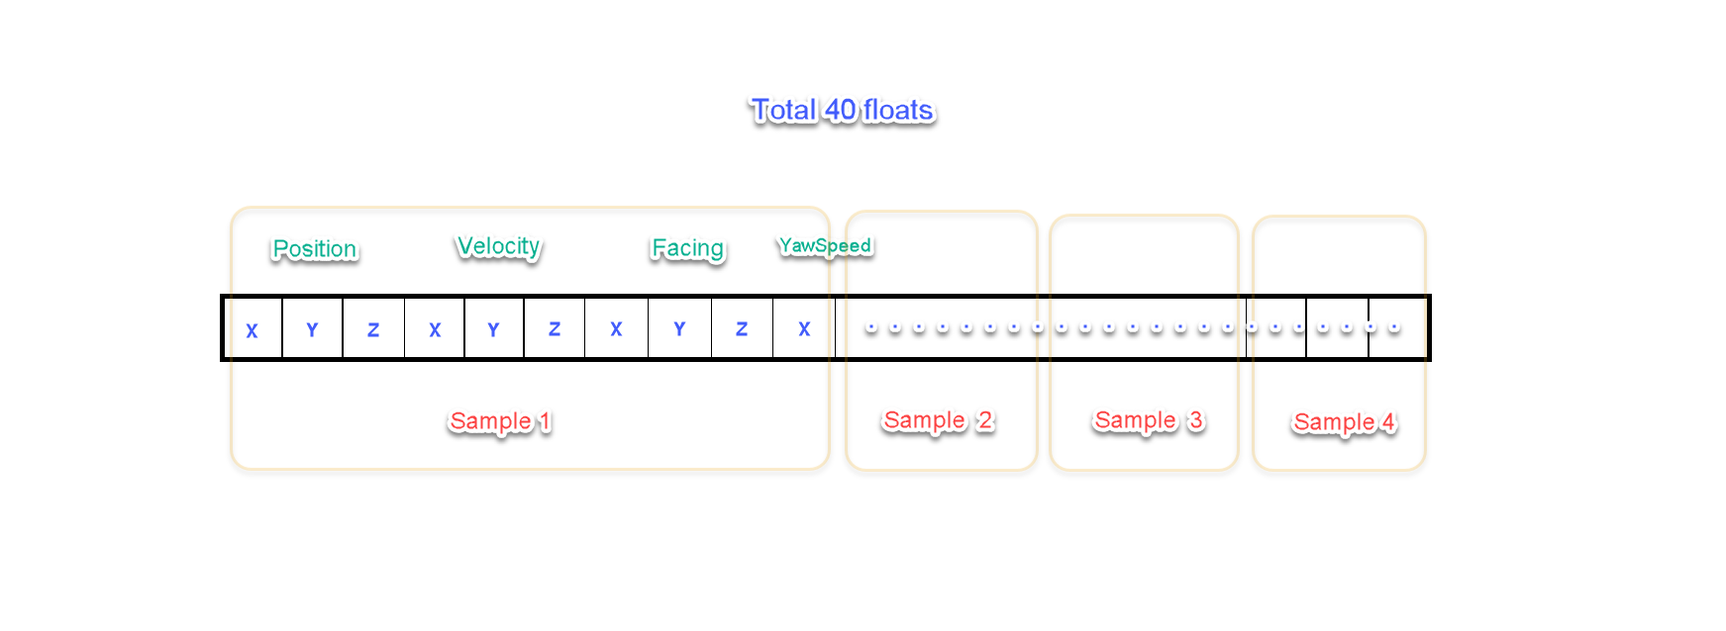
Look at the data
Notes:
Let’s learn the data a bit.
4 samples for trajectory:
(4 * (kPosCount + kVelCount + kFacingCount + kYawSpeedCount)) => 40 floats
Combine these 2 vectors, each pose can be represented as a 61dimension vector.

Slide 40
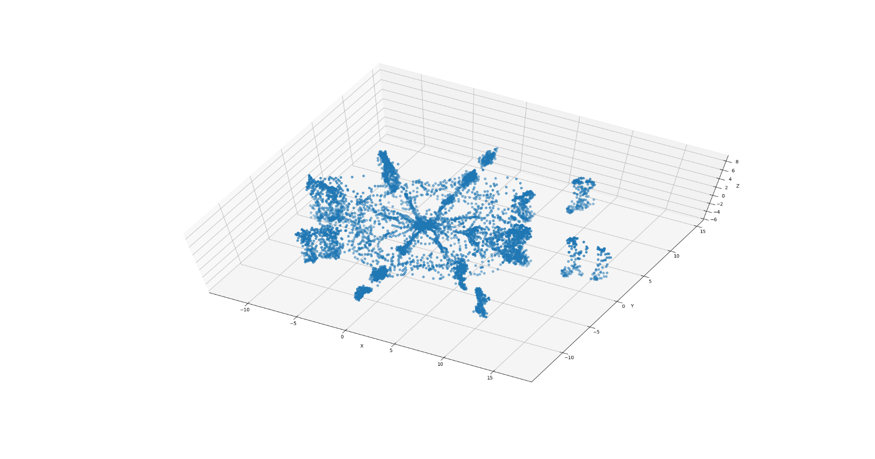
Plot the data
Notes:
Let’s plot the data:
There’re 8866 poses total.
Each point on this graph represents a combined pose/trajectory vector we just talked about, which is 61dimension vector.
It’s very important so I will repeat it.
Each point here represents a combined pose/trajectory vector, which is 61dimension vector.
It’s a high dimension vector we can’t directly plot it.
For visualization purpose, use PCA to reduce dimension to 3 so I can plot them using 3D space.
What do we learn from this?

Slide 41
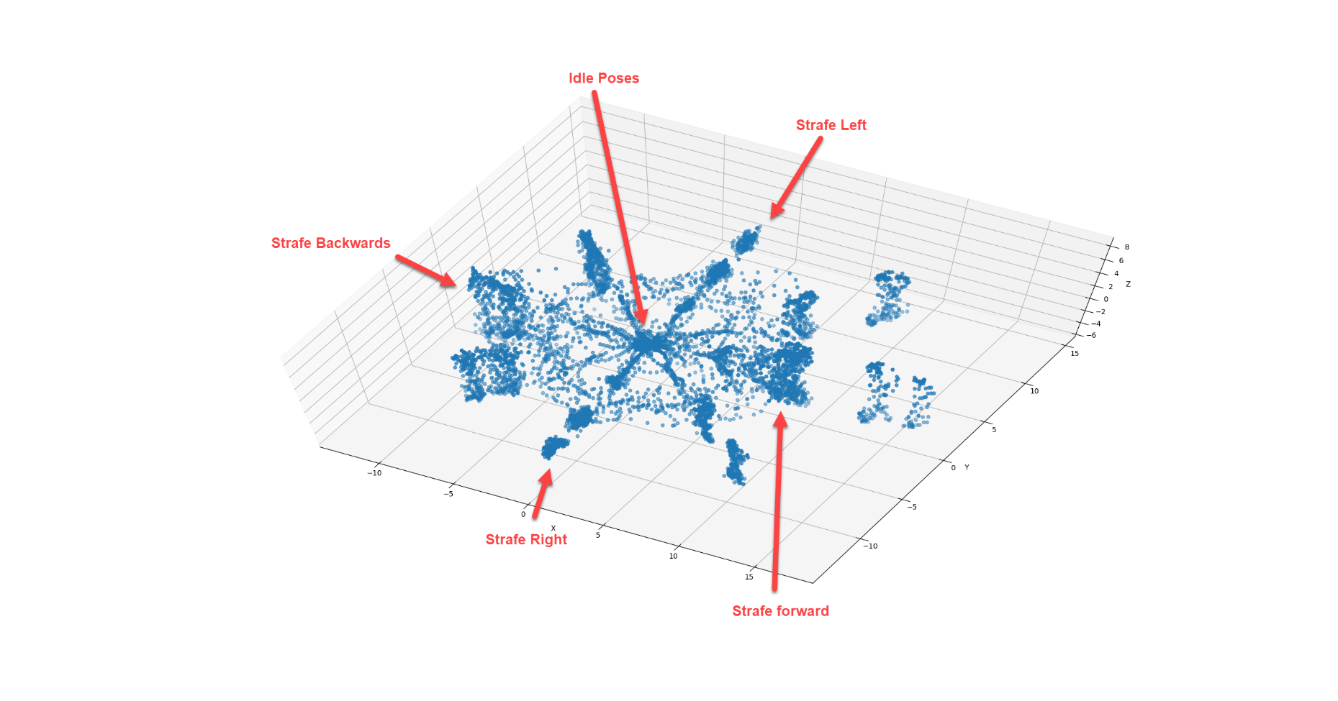
Plot the data
Notes:
We find here is similar trajectories and poses trend to be close.
The center points are idle poses.
Explain running poses, walking poses.
From that: we know It’s a waste to search poses/trajectories which are far from desired pose/trajectory.
For example:
If my character wants to move to right, we only want to search moving right trajectories.
There’s no point to search idle poses, moving backward or forward trajectories. They’re too far away.

Slide 42
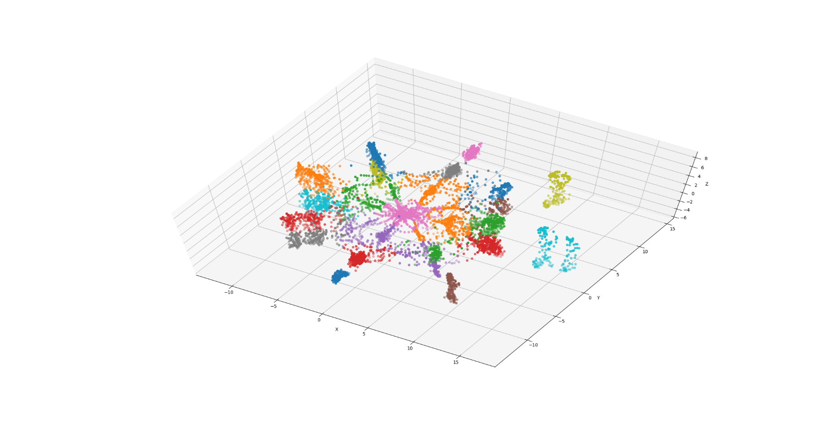
Cluster the data (KMean) offline
Notes:
Since similar pose/trajectories are closer, so we can use some clustering algorithm to group them.
I am using KMean algorithm here, it’s very simple and fast. After that, we see one color means one cluster.
I will say this clustering algorithm is the core of MM.
Given an input, traditional locomotion system requires programmer or animator to hardcode a list of candidate animations.
For example:
If character needs turn right, programmer needs to hardcode a list of turn right animations and pick the best one based on input.
Here the clustering algorithm is doing exactly the same thing. But it’s automatic by learning the similarity of the data.

Slide 43

kmeans
Notes:
If you are not familiar with K-means algorithm.
Here’s a quick summary:
Start with some random points as cluster centers.
For each iteration, for each point, calculate the distance between that point with cluster centers and assign the point to the closest cluster.
Then update the cluster center by calculating the mean.
Continue this iteration until it’s converged.

Slide 44
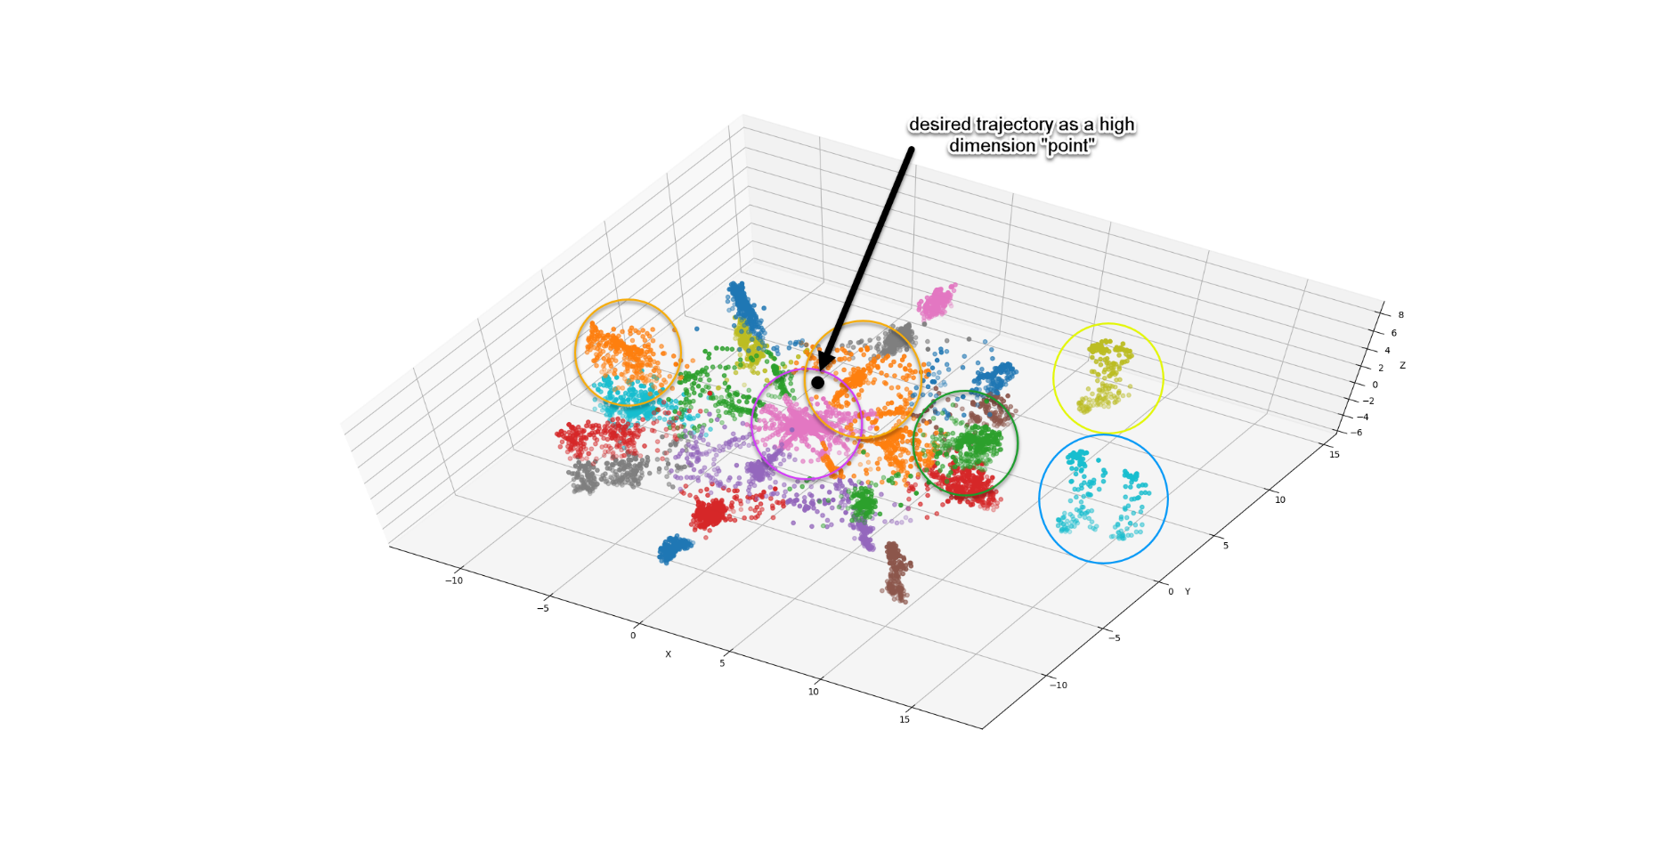
Bound spheres
Notes:
Once we have the clusters, the next step is to build a bounding sphere for each one of them.
Let’s say the desired trajectory is this black dot.
For example, the black point is the desired trajectory. We can see it’s in pink and orange cluster’s bounding sphere.
We only need run search algorithm in these 2 clusters. We don’t need search those faraway clusters.
This will greatly reduce the search space.

Slide 45
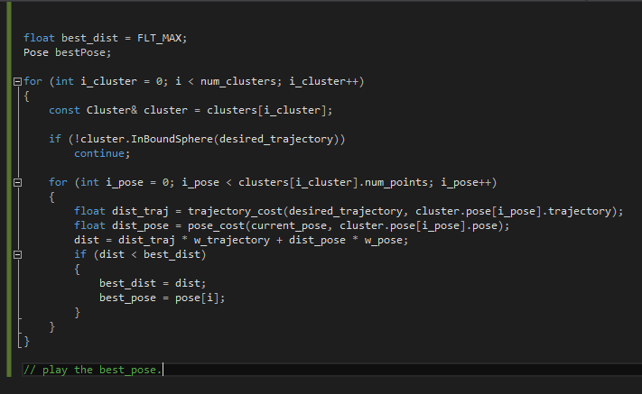
Run time code
Notes:
Clustering and building bound spheres are done offline.
This is the new run time code.
It first iterates through number of clusters and find the desired trajectory is in the bound sphere.
Skip those cluster which is far away.
Then the rest is the same as previous algorithm.

Slide 46
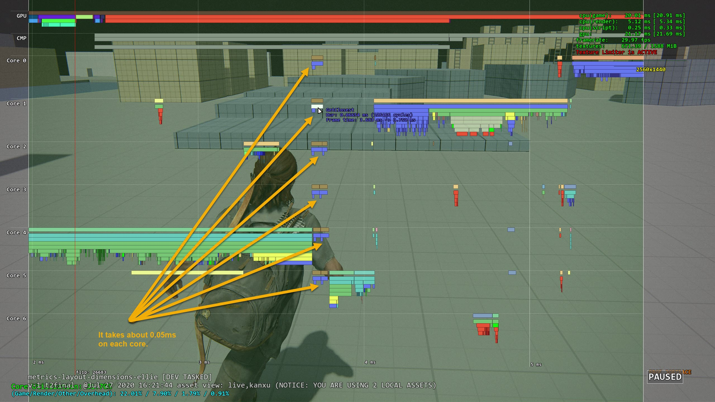
Result
Notes:
We can also distribute it on multiple cores and use SIMD.
This is the final result, it takes 0.03ms for each core.
For npc, it takes less because they have less poses in each cluster.
Now we don’t have any problem running 1 player + 16 npcs at the same time.
Other system becomes the bottleneck, like path finding, which is more expensive than MM.

Slide 47
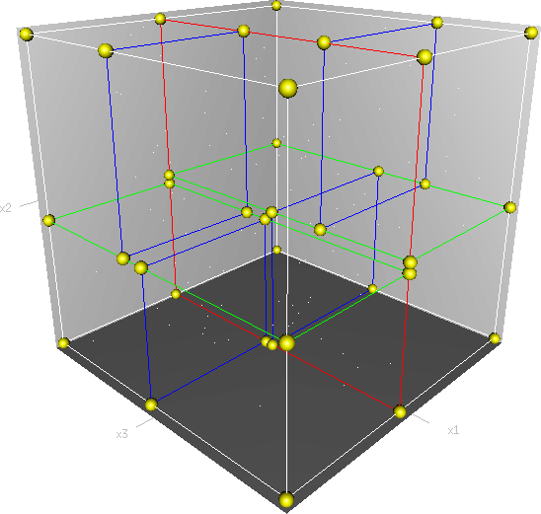
Other optimization idea
Clustering poses using multiple dimension Kd-Tree
Maybe use PCA to reduce dimension first.
Notes:
How about other optimization idea?
We use Kmean, Ubisoft Toronto says they use Kd-tree to cluster.
We didn’t try that because kmeans already solve the problem.
If I have time, I would like to implement Kd-tree so I can compare the performance difference.
People says Kdtree doesn’t perform well if dimension is big. We do have high dimension vector so it’s interesting to see the result.
If that’s true, maybe we can try use PCA to reduce dimension first, just like we plot the data.

Slide 48
What else?
Character Movement driven by root motion or procedurally?
Procedural character rotation.
Scale animation playback speed to match desired speed.
Foot pinning IK.
Notes:
What else do we need?
We need think about a question, whether to use root motion to move character or simply by procedural curve.
TLOU2 uses root motion to drive character’s movement so we can achieve most grounded quality. Some other games has less animation requirement can just use procedural speed to move the character. And MM just tries to do best match.
2nd is: … Because there’s no animation will perfect match the desired trajectory, we need procedurally rotate the character to match the trajectory. This is extremely important for AI characters to follow the path.
3rd is: . This will make character movement speed feel smooth.
4th is Foot pinning IK. We need evaluate ankle speed in world space. It’s below certain threshold, it should be pinned on the ground.
It fixes the foot sliding during procedural rotation and animation blending. A 2 bone IK should do the job.

Slide 49
Strafing MM Demo
Notes:
With all of that, let’s see the result.

Slide 50
How about other animation system?
Motion matching suits locomotion naturally
The principle is applicable to other types of movements.
Use different key joints
Can be used to replace phase matching.
Consideration to use motion matching:
How complex if it’s implemented by State-Machine?
Notes:
So far we are using MM for locomotion, how about other movement system?
MM fits locomotion very well.
But the same principle can be applied to other types of movements.
We use it for aiming gun, swimming, push dumpsters, horses and dogs, etc.
There’re many cool videos demonstrating we mocap horse and dog, if you are interested.
Think about what’s the important features of a system?
If you want to use MM for climbing, probably the most important joints will be hands instead of ankles.
It can be used to replace “phase matching”. So we already know what animation to play, we can ask MM to give us the best frame.
Some consideration to whether to use MM or traditional state machine?
If the system can be implemented by a few states, MM is not worth it.
If the system can be very complicated, MM could be a great idea.

Slide 51
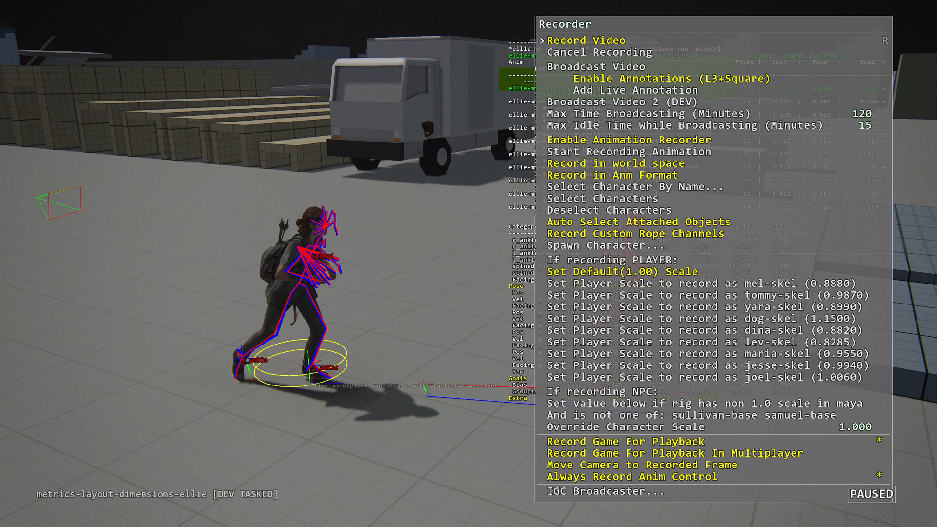
Debugger
Notes:
The next slide is about debugging.
I am pretty sure once MM is implemented, animators will come by and ask questions like why this animation is not playing.
A in game debugger will be key to programmer and animators when debugging MM:
A few features are must-have:
Show desired trajectory
Show candidate trajectory
Show weights of motion matching set and modify weights in run time.
Show how the cost is calculated. animators can type one animation name and know why it is not selected.

Slide 52
Pros & Cons
Pros:
It saves a lot programmer time
It reduce code complexity
Animators can focus on making cool anims and it will just work.
Cons:
Need some time tweaking to get specific anim to play
Increase memory bucket
Mirroring doubles CPU costs
Notes:
Overall we think MM is a big win, it’s worth it.

Slide 53
How does MM affect animator workflow?
No markup needed
Animation Clips are recommended:
Clips can remove redundant data
Mental shift: animators need take more ownership.
Organize the motion matching set.
Play with weights to find best combination.
Notes:
How does MM affect animator workflow?
First, they don’t need do a lot tagging, which is good.
Ubisoft says they capture 4 minutes mocap data which they call it dance card.
We just use existing animation clips, combine them into a motion matching set, and it also works. Using clips also have the advantage of removing redundant data. That helps performance.
Mental shift: for the traditional system, once animation clips are created, animators’ job is done. Usually they will ask programmer to hook it up.
With MM, animators need take extra step to
Of course there’s a learning curve, but once they are skilled, they can make animation happen in game without programmer’s help.
From our animators feedback, and they all loved it and there’s no going back.

Slide 54
Conclusion
MM is data-driven approach which greatly improves animation quality.
Motion matching will be next-gen AAA game standard.
Reference: Michael Buttner [Motion Matching - The Road to Next Gen Animation]

Slide 55
Q&A

